Slide 1
FRAUD DETECTION SYSTEM USING MACHINE LEARNING

Slide 2

Project Overview
16-week ML fraud detection system development project
Four-member team with structured implementation phases
Target 95% accuracy with under 2% false positives
Real-time processing under 500ms response time
Complete solution with models, infrastructure, and APIs

Slide 3

Project Objectives and Deliverables
Smart system using Random Forest, Gradient Boosting, Neural Networks
Real-time engine processing 10,000+ transactions per minute
Monitoring dashboard for fraud patterns and system metrics
Focus on credit card and online payment fraud detection
Complete documentation and user manuals included

Slide 4
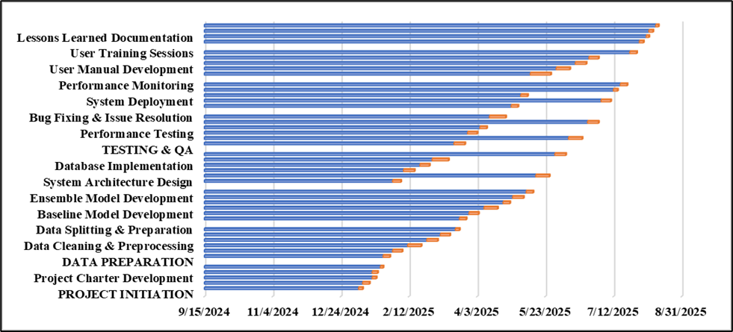
Gantt Chart - Fraud Detection System Using Machine Learning
This Gantt chart outlines a detailed timeline for developing a machine learning-based fraud detection system, including phases like initiation, data preparation, model development, testing, deployment, and documentation from September 2024 to August 2025.

Slide 5
Project Timeline and Critical Path
16 weeks timeline: January 6 - April 28, 2025
Critical path: Formation → Requirements → Data → Models → Testing → Deployment
Weeks 1-2: Project setup and planning
Weeks 3-6: Data preparation phase
Weeks 7-11: Model development phase

Slide 6

Resource Allocation and Dependencies
Weeks 12-14: System integration phase
Weeks 15-16: Testing and deployment
Data prep depends on completed requirements gathering
Model development needs finished feature engineering
Integration testing requires both models and APIs ready

Slide 7

Risk Management Strategy
Technical risks: Model performance and algorithm issues
Data quality risks requiring validation and multiple sources
Integration challenges with existing banking systems
Performance risks affecting scalability and response times
External risks from regulations and market changes

Slide 8
Change Management Process
Structured change control framework for modifications
Formal submission and impact analysis workflow
Multi-perspective stakeholder review process
Authority-based approval levels for different change types
Complete documentation and audit trail maintenance

Slide 9
Success Criteria and Expected Outcomes
Achieve 95%+ accuracy with under 2% false positives
Maintain sub-500ms real-time response times
Process 10,000+ transactions per minute capacity
Seamless integration with existing banking systems
Meet organizational objectives within timeline and quality standards

Slide 10
Conclusion
Robust 16-week framework for ML fraud detection system
Structured approach with clear phases and dependencies
Proactive risk and change management processes
High-performance real-time fraud detection solution
Enhanced security with reduced false positives for financial institutions

